Slide 1
DVMP: Form Factors, Box Diagrams, and Gauge Invariances
Andrew Lundeen
Research Talk for November 10th, 2017

Slide 2
Quick Review (1)
DVMP: Deeply Virtual Meson Production
Electron beam scatters off a scalar (spinless) target inelastically; electron + target -> electron + target + meson
Write a differential cross section for the process. We use Bjorken variables (Lorentz invariant), the Target Rest Frame (TRF), WJC coordinates typically
Differential cross section is proportional to the square amplitude. Normally in class one would compute Feynman diagrams, but the scalar target has many constituent particles
Can write the amplitude as a product of currents; write the current of the hadronic interaction in terms of form factors

Slide 3
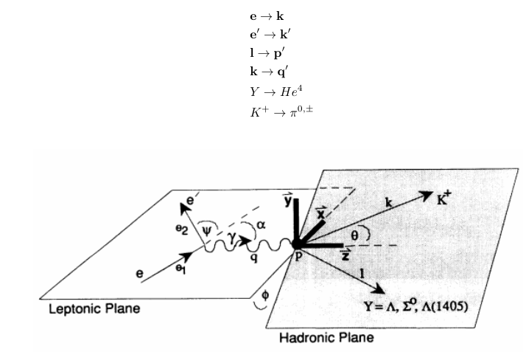
Quick Review (2)

Slide 4

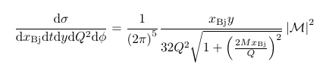


Quick Review (3)
Definition of Bjorken Variables:
Differential cross section in the TRF:
Total amplitude is proportional to
hadronic amplitude:
Hadronic amplitude depends
on whether a pseudoscalar
or scalar meson is produced:

Slide 5

Introduction to the Box Diagram
So far, everything has been model-independent
Form factors can be extracted from the experimental data
The box diagrams are a model for computing the value of the form factors theoretically; we would like to compute a result and compare this to the model-independent approach
We can use the box diagrams as a way to connect to GPDs and show whether or not their structure is sound by comparing to the form factors found in the model-independent approach
Gauge Invariance Condition:

Slide 6
The Box Diagram Model
We will not be looking at the leptonic part of the overall reaction; “M” in the following equations now stands for the “H” in previous equations.
For the box diagram calculation, we will assume that the scalar target is two constituent fermions and antifermions with equal mass.
In the next figure, the s and u-channel diagrams may appear familiar. The so-called “cat’s ears” diagram is also needed, however, to satisfy gauge invariance for scalar meson production

Slide 7
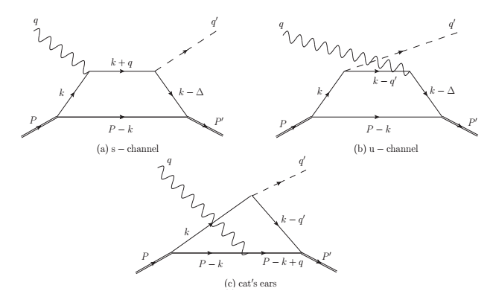

The Box Diagrams

Slide 8
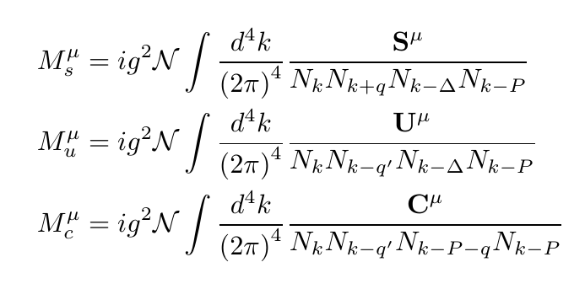
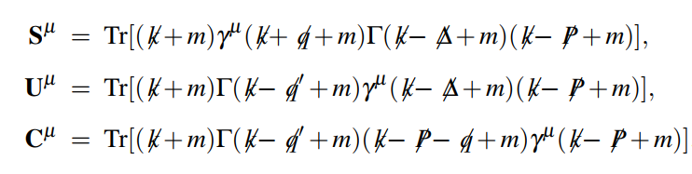

Calculation of the Amplitude (1)

Slide 9
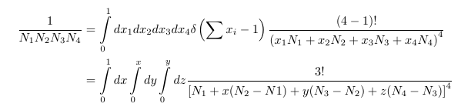
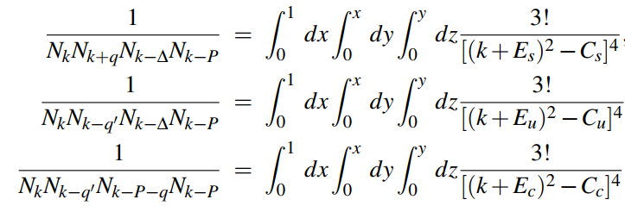
Feynman Parametrization
Notes:
First equation is from Peskin-Schroeder 6.41. Second equation matches (15-28) of Klauber.

Slide 10

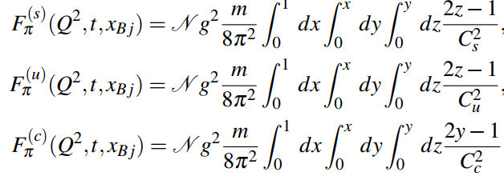
Calculation of the Amplitude (2)
Pion Production:

Slide 11
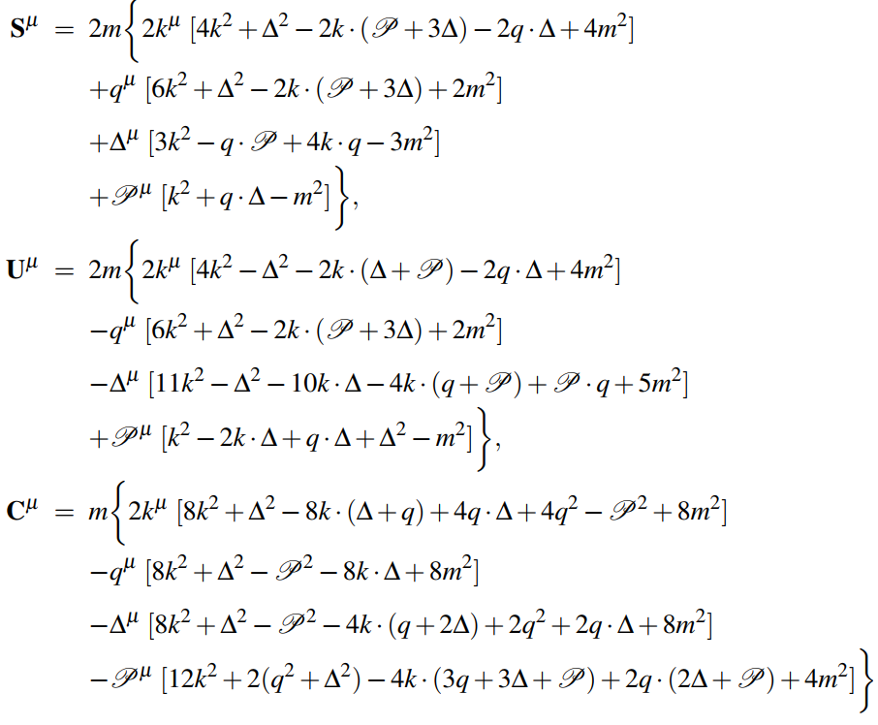
Calculation of the Amplitude (3)
Scalar Meson Production

Slide 12




Calculation of the Amplitude (4)
It quickly gets messy for the scalar meson. However, it simplifies to the following overall structure

Slide 13
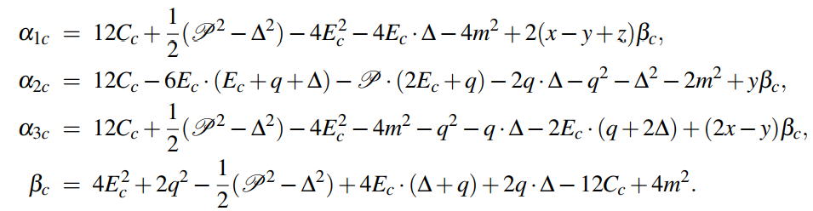
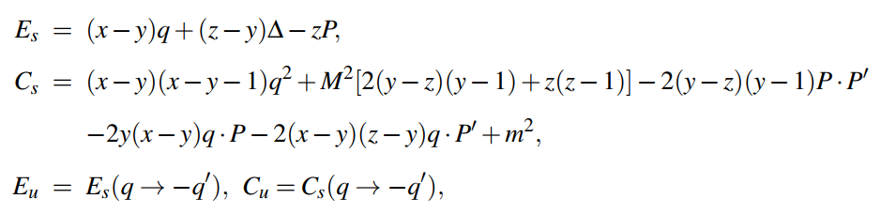
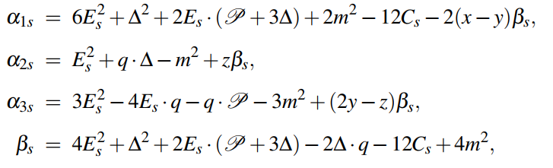
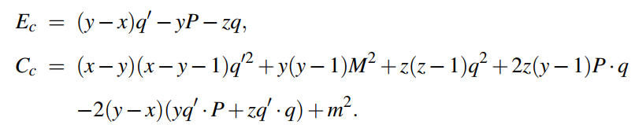
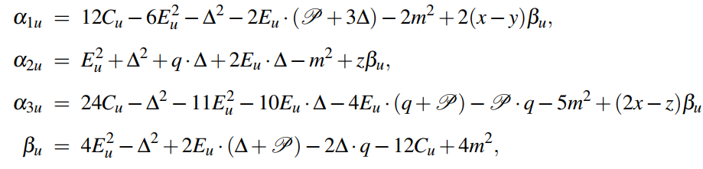
Defining quantities from previous slide
You might want a computer to help!

Slide 14
Contact Diagrams (1)
Main idea: spectator fermion is taken to be very massive -> very far off-shell -> doesn’t propagate very far -> spectator line contracts to a point
Only the s and u-channels contribute. The cat’s ears diagram vanishes. (Proof by Dr. Ji)

Slide 15
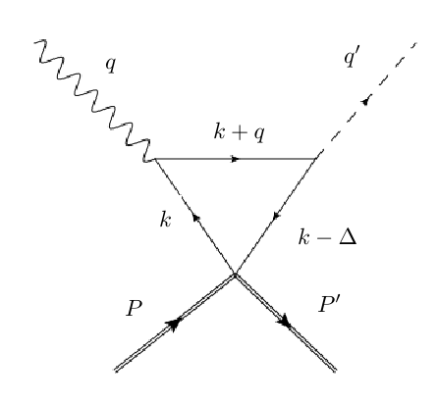
Contact Diagrams (2)
Very similar process as the box diagrams, but now the Feynman parametrization involves only two integrals; the overall fermion loop is only 3 propagators, not 4
s-channel:

Slide 16
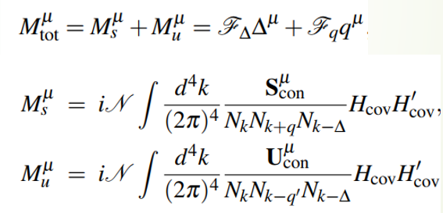
Contact Diagrams Amplitude (1)

Slide 17
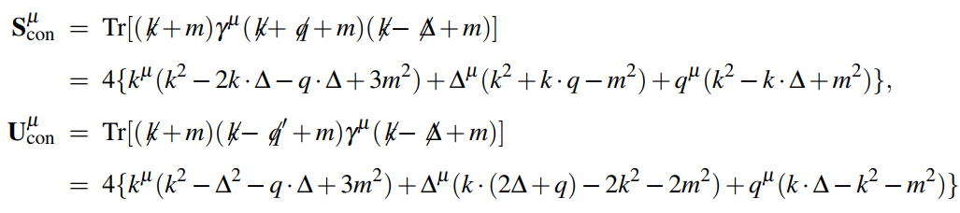
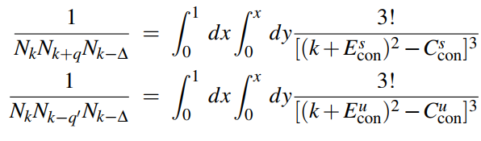
Contact Diagrams Amplitude (2)
(Scalar meson production: Gamma -> 1)

Slide 18

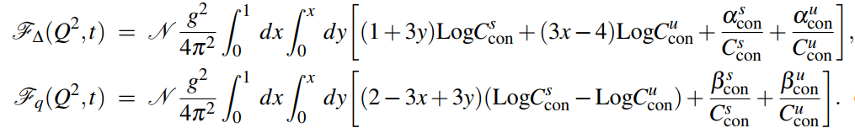

Contact Diagrams Amplitude (3)
Gauge invariance condition:

Slide 19
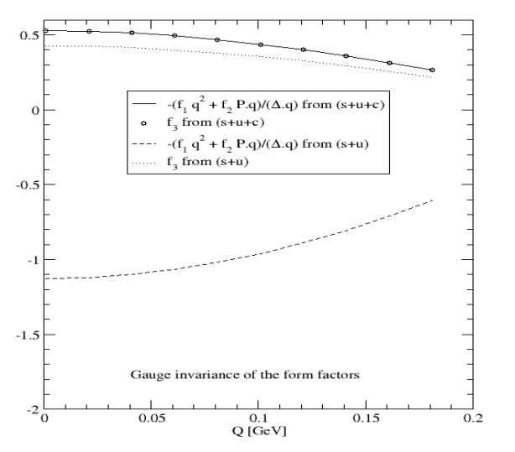
Numerical Work (1)
This result shows that all three channels are needed for gauge invariance to be satisfied in the box
diagram for scalar meson production.

Slide 20
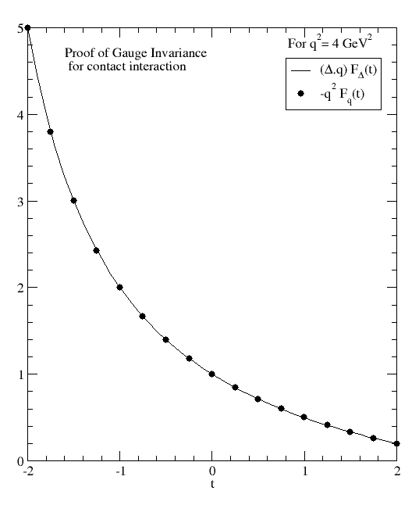
Numerical Work (2)

Slide 21
Summary
Model-Independent Approach
Box Diagrams (model-dependent approach)
Gauge Invariance:
Pion: each channel satisfies separately
Scalar meson: must include the cat’s ears diagram
Contact Diagrams
Scalar meson: cat’s ears diagram vanishes; still need to show that amplitude reduces to a single form factor numerically
Compare model-independent results with box/contact diagrams, which in turn connects with the GPD formulation

